Slide 1
Reinforcement-Learning-Based
Hyper-Heuristic for Feature
Selection in Disease Prediction
11/30/2026
Emerging Topics in AI — Option 2: Real-World AI
Research and Implementation Project
Jihane Ahmad Lagha
Department of Computer Science, Beirut Arab University
Notes:
Introduce the project title and explain that this presentation summarizes the implemented research report: an RL-based hyper-heuristic for feature selection in disease prediction.

Slide 2
Presentation roadmap
From motivation to final results and interpretation
01
Problem & research motivation
Why feature selection matters in healthcare AI
Key theme
Proposed RL hyper-heuristic
The study does not assume that RL must win. It tests whether adaptive heuristic selection can produce compact, high-performing subsets under strong comparisons.
02
Q-learning selects ADD / REMOVE / SWAP / FLIP
03
Experimental design
Datasets, baselines, metrics and statistical tests
04
Results
Diabetes, heart disease and cross-dataset interpretation
Conclusion
Balanced conclusion
05
What the evidence supports and what remains limited
Reinforcement-Learning Hyper-Heuristic for Feature Selection
2
Notes:
Walk the audience through the presentation flow and highlight that the project emphasizes rigorous comparison, not overclaiming.

Slide 3
Why feature selection matters
Healthcare models often contain variables with unequal predictive value
21
13
2^d
Feature selection as search
Diabetes predictors
Heart predictors
candidate subsets
large survey dataset
small clinical dataset
combinatorial search
Full feature set
Many variables
Some variables may be redundant, weakly informative or costly to collect.
Smaller feature sets can improve simplicity, efficiency and interpretability.
The challenge: selecting fewer variables without losing predictive discrimination.
Candidate subset
Binary vector z
Classifier evaluation
ROC-AUC
Compactness penalty
fewer selected features
Reinforcement-Learning Hyper-Heuristic for Feature Selection
3
Notes:
Explain the motivation: feature selection is both a predictive and optimization problem. We seek compact subsets without destroying predictive performance.

Slide 4
Research gap and contributions
Testing adaptive operator selection against strong baselines
Research gap
Main contributions
Conventional feature selection, hyper-heuristics and RL feature selection are often studied separately. This project tests their intersection: Q-learning as a high-level controller over feature-subset modification operators.
Q-learning selects among ADD, REMOVE, SWAP and FLIP operators.
Objective balances ROC-AUC with subset compactness.
Two healthcare datasets with different sample sizes are evaluated.
Comparisons include All Features, SelectKBest, L1 and RFE.
Wilcoxon tests with Holm correction support statistical interpretation.
Goal: evaluate, not overclaim
Valid outcomes: RL may improve performance, match performance with fewer features, or show that simpler baselines remain stronger.
Reinforcement-Learning Hyper-Heuristic for Feature Selection
4
Notes:
State the research gap and contributions clearly. Emphasize that the design is an adaptive hyper-heuristic, not a direct feature-by-feature RL selector.

Slide 5
Problem formulation
A feature subset is a binary vector optimized for performance and compactness
Search-space scale
Candidate subset
z ∈ {0,1}ᵈ
zⱼ = 1 means feature j is selected; k = Σ zⱼ selected features.
2,097,152
8,192
Diabetes subsets
Heart subsets
2²¹ possible subsets
2¹³ possible subsets
Exhaustive search is impractical or unnecessary for the larger dataset.
Wrapper evaluation uses Logistic Regression and ROC-AUC.
The RL controller learns which type of search move to apply.
Objective
J(z) = ROC-AUC(z) − λ × (k / d), λ = 0.02
Interpretation: strong AUC is prioritized; among similar AUC values, fewer selected features are rewarded.
Reinforcement-Learning Hyper-Heuristic for Feature Selection
5
Notes:
Define the mathematical objective and why the penalty is mild. The aim is not just smaller subsets, but compact subsets that retain discrimination.

Slide 6
Datasets and preprocessing
Primary large-scale dataset plus secondary validation setting
Characteristic
CDC Diabetes
UCI Heart Disease
Observations
253,680
303
Input features
21
13
Target
Binary diabetes
num > 0 = disease
Missing values
0
6
Preprocessing
standardization + balanced class weights
median imputation + standardization
Role
primary case study
secondary validation
Diabetes: stable large-sample evaluation
Heart disease: smaller and noisier validation
Reinforcement-Learning Hyper-Heuristic for Feature Selection
6
Notes:
Explain the two evaluation settings. Diabetes is the main large dataset, Heart Disease tests stability under a much smaller sample size.

Slide 7
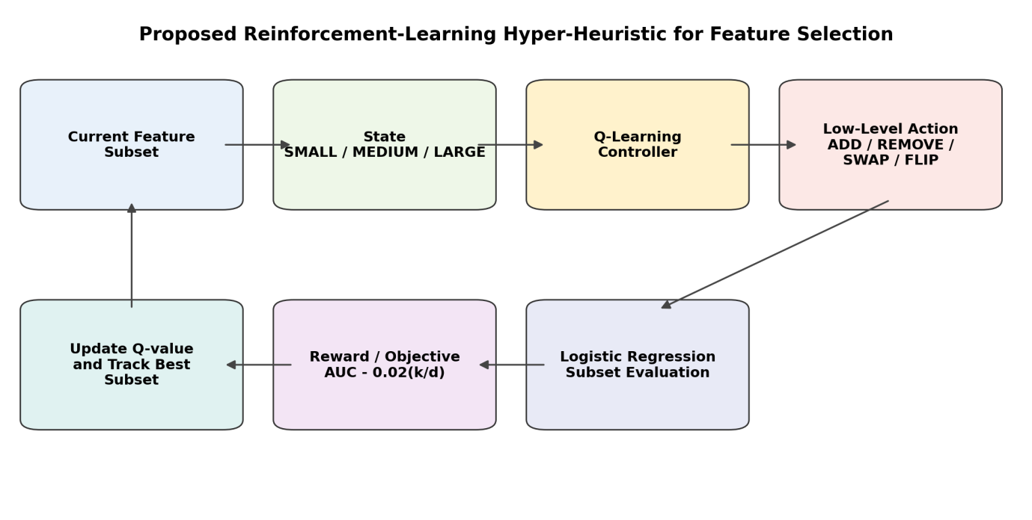
Proposed Q-learning hyper-heuristic
The agent learns which search operator to use, not which feature directly
State is a compact subset-size category: SMALL, MEDIUM or LARGE.
Action selects one low-level heuristic: ADD, REMOVE, SWAP or FLIP.
Reward is the change in performance-compactness objective.
Best subset is tracked and evaluated on held-out data.
Reinforcement-Learning Hyper-Heuristic for Feature Selection
7
Notes:
Use the architecture diagram to describe the loop: current subset, state, Q-learning controller, operator, subset evaluation, reward, and Q-value update.

Slide 8
Operator layer and Q-learning policy
A compact controller chooses among complementary search moves
ADD
REMOVE
SWAP
FLIP
include one excluded feature
remove one selected feature
replace one selected feature
toggle one feature bit
Q-update rule
Policy settings
Q(s,a) ← Q(s,a) + α [ r + γ max Q(s′,a′) − Q(s,a) ]
α = 0.20 γ = 0.80 ε starts at 0.30
ε decays by 0.95 and is bounded at 0.05
Reward = change in objective J(z)
Reinforcement-Learning Hyper-Heuristic for Feature Selection
8
Notes:
Explain that the policy is simple and interpretable. The controller learns which move type tends to improve the objective in each subset-size state.

Slide 9
Experimental methodology
Strong baselines and repeated statistical testing
Predictive model
Logistic Regression with standardized features
Baselines
All Features, Random/fixed heuristics, SelectKBest, L1, RFE
Evaluation
Repeated splits; held-out ROC-AUC and compactness objective
Statistics
Paired Wilcoxon signed-rank tests + Holm correction
Final repeated comparisons
Diabetes: 10 outer splits • Heart Disease: 30 repeated splits
Reinforcement-Learning Hyper-Heuristic for Feature Selection
9
Notes:
Describe the experimental protocol. Emphasize that final performance is based on held-out test partitions, not on the same validation data used for searching.

Slide 10
Exploratory Diabetes heuristic comparison
No single low-level operator dominated all search behavior
Method
Mean AUC
Features
Reduction
Objective
ADD
0.8176
14.53
30.8%
0.8038
Interpretation
FLIP
0.8156
12.73
39.4%
0.8035
ADD, SWAP and RANDOM reached similar AUC values.
REMOVE reduced more features but hurt AUC.
RL was competitive but not clearly superior at this stage.
RANDOM
0.8173
13.70
34.8%
0.8043
REMOVE
0.8120
11.67
44.4%
0.8009
SWAP
0.8175
13.83
34.1%
0.8043
RL
0.8179
14.13
32.7%
—
Rationale for adaptive control
The heuristic behavior varies by operator, so learning when to use each operator remains conceptually justified.
Reinforcement-Learning Hyper-Heuristic for Feature Selection
10
Notes:
Discuss the early heuristic comparison. It provides motivation for adaptive selection but also shows that RL should be compared carefully.

Slide 11
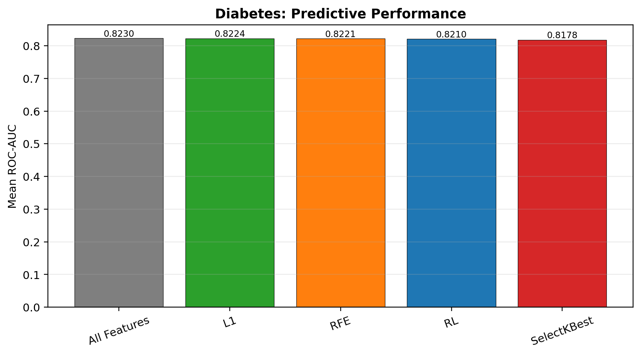
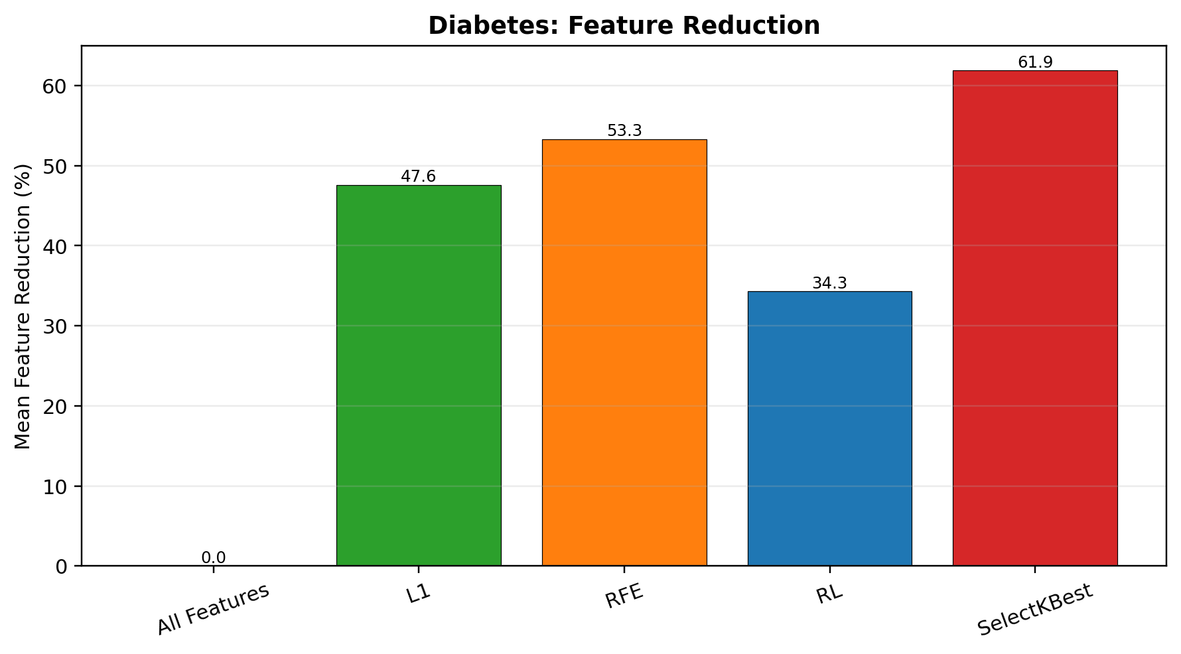
Final Diabetes results
RL preserved most AUC while reducing about one-third of features
0.8210
13.8
34.3%
0.8079
RL mean ROC-AUC
mean features
feature reduction
RL objective
all features: 0.8230
from 21 predictors
average reduction
all features: 0.8030
Reinforcement-Learning Hyper-Heuristic for Feature Selection
11
Notes:
Summarize the final Diabetes results. RL loses only about 0.0019 AUC compared with all features while removing 7.2 features on average.

Slide 12
Diabetes statistical interpretation
The result is useful, but strong conventional baselines remain better overall
Comparison
Δ AUC
Holm p
Δ Features
Δ Objective
RL vs All Features
−0.001924
0.007812
−7.20
+0.004933
RL vs L1
−0.001373
0.007812
+2.80
−0.004039
RL vs RFE
−0.001104
0.019531
+4.00
−0.004914
RL vs SelectKBest
+0.003235
0.007812
+5.80
−0.002288
Supported claim
Cautious interpretation
RL is effective at producing compact, high-performing subsets and improves the objective over the full-feature model.
RFE and L1 achieve stronger performance-compactness trade-offs on Diabetes, so RL is not the best final method.
Reinforcement-Learning Hyper-Heuristic for Feature Selection
12
Notes:
Explain the Wilcoxon-Holm statistical results for Diabetes: small AUC losses are significant due to stable large sample, and conventional methods achieve better objective.

Slide 13
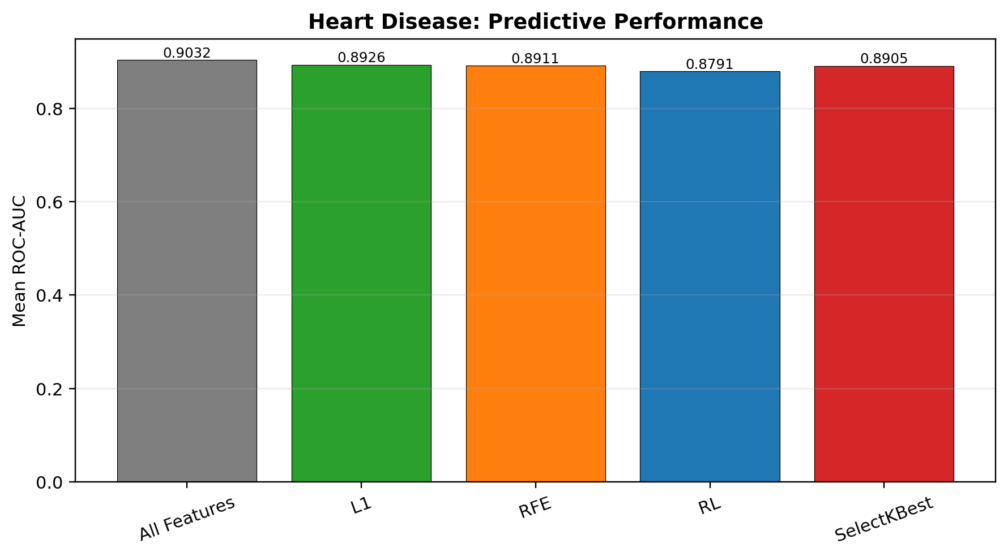
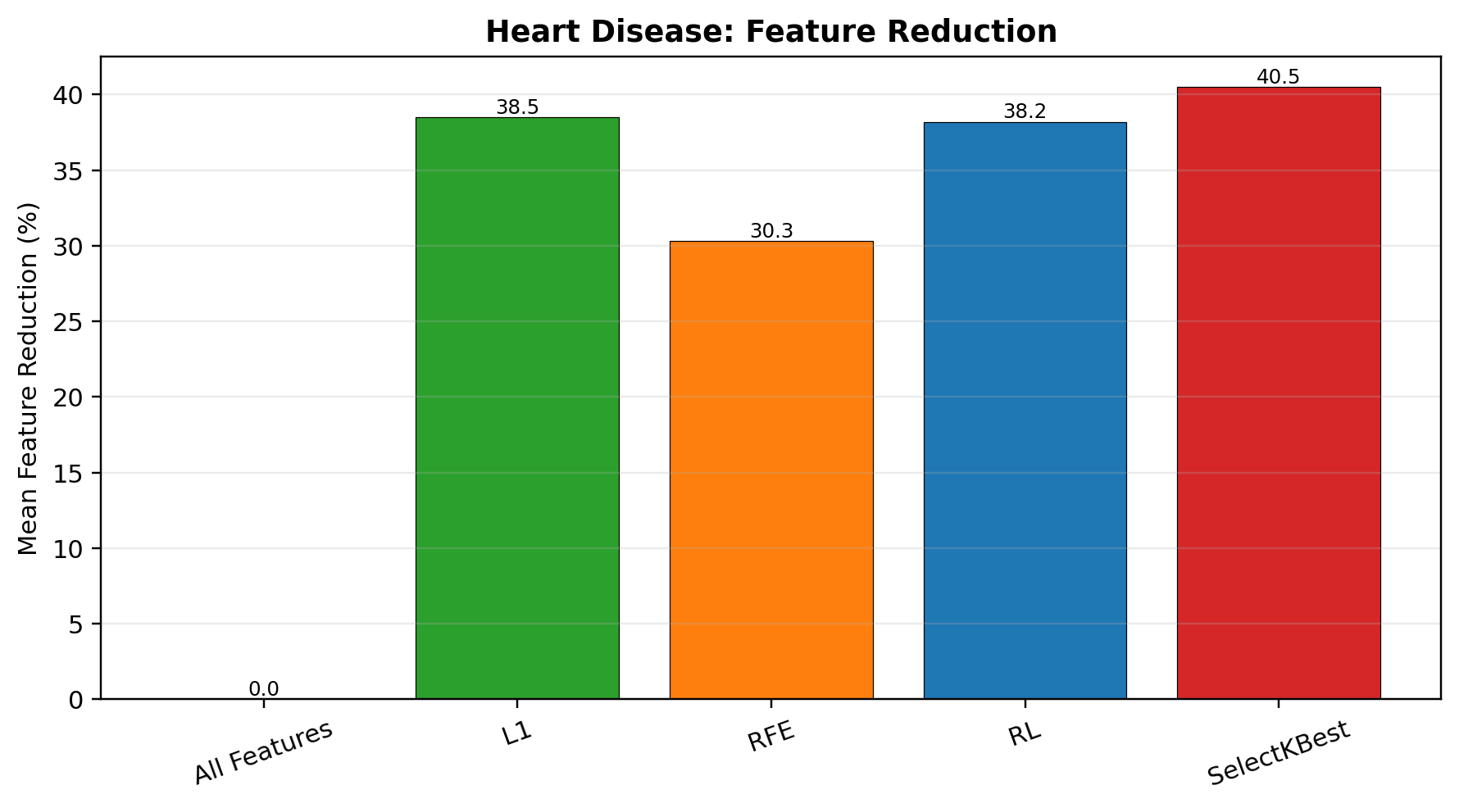
Final Heart Disease results
The small dataset exposes instability and weaker RL performance
0.8791
8.03
38.2%
0.0373
RL mean ROC-AUC
mean features
feature reduction
RL AUC std.
all features: 0.9032
from 13 predictors
average reduction
higher variability
Reinforcement-Learning Hyper-Heuristic for Feature Selection
13
Notes:
Summarize the Heart Disease result: RL reduces features, but the performance loss is larger and variability increases compared with Diabetes.

Slide 14
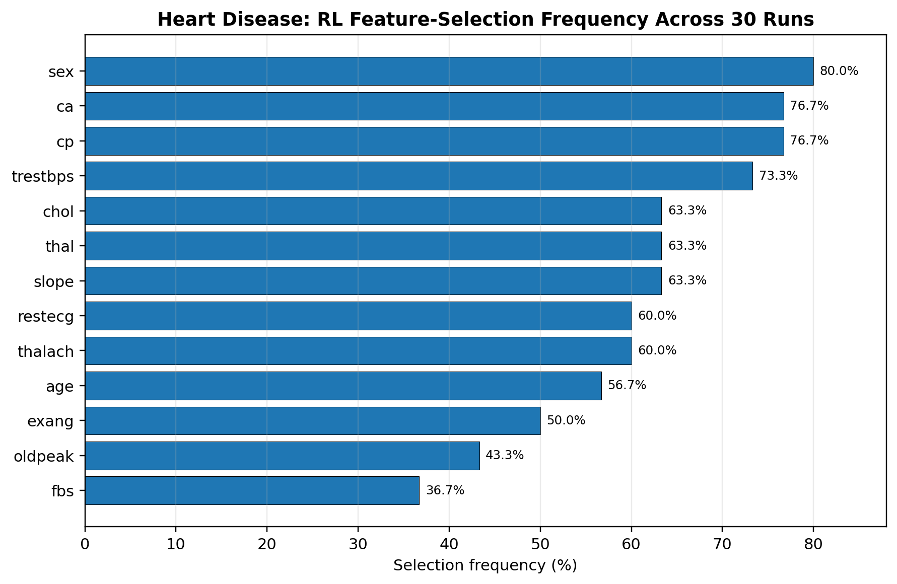
Heart Disease interpretation
RL selected meaningful subsets but did not outperform strong baselines
Statistical takeaway
RL is significantly worse than All Features in AUC and objective.
RL is also weaker than L1 for both AUC and objective.
Differences from RFE are not significant after Holm correction.
Frequent selection does not imply clinical causality.
Top selected: sex, ca, cp, trestbps
Reinforcement-Learning Hyper-Heuristic for Feature Selection
14
Notes:
Use the feature-frequency chart to show that RL repeatedly selects some variables, but also stress that this is not clinical causality.

Slide 15
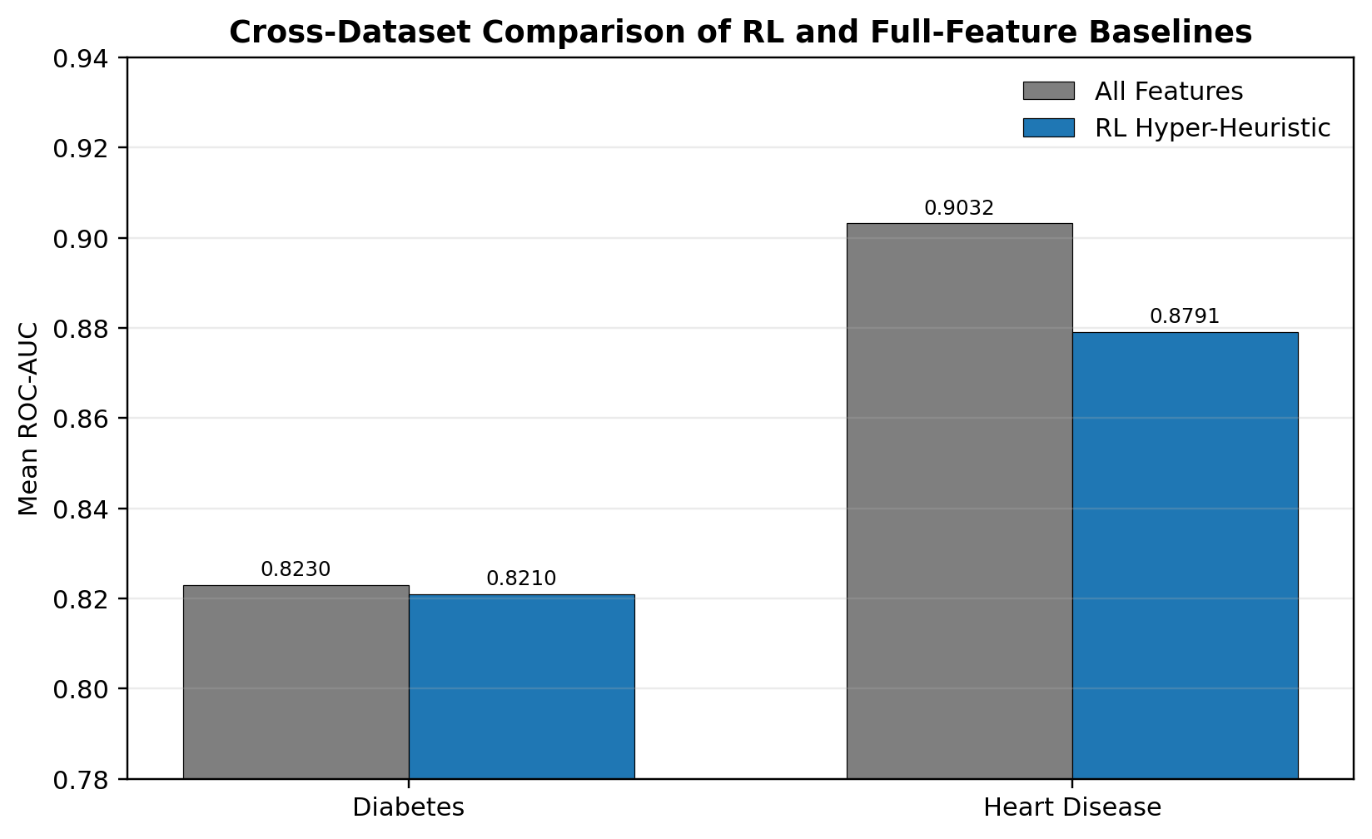
Cross-dataset analysis
Same search concept, different operating regimes
Diabetes
AUC gap ≈ 0.0019
Feature reduction = 34.3%
Heart Disease
AUC gap ≈ 0.0241
Feature reduction = 38.2%
Interpretation: dataset size, noise, features and preprocessing all affect search stability. Dataset size alone should not be treated as the only cause.
Reinforcement-Learning Hyper-Heuristic for Feature Selection
15
Notes:
Compare Diabetes and Heart Disease. The key point is that RL is more competitive on the large Diabetes dataset and less stable on Heart Disease.

Slide 16
Discussion and limitations
Adaptive search is viable, but the simple RL design is not universally superior
What the results support
Main limitations
Q-learning can act as a high-level feature-selection controller.
The method discovers substantially smaller feature sets.
On Diabetes, AUC remains close to the full-feature model.
Strong baselines are essential for fair evaluation.
State encodes only subset size, not feature identity.
Low-level heuristics modify features randomly.
Only Logistic Regression is used for wrapper evaluation.
λ = 0.02 is fixed; other costs may require different trade-offs.
No external clinical cohort or deployment validation.
Reinforcement-Learning Hyper-Heuristic for Feature Selection
16
Notes:
Emphasize the balanced discussion: RL is feasible and interpretable but limited by simple state representation and strong conventional baselines.

Slide 17
Conclusion and future work
A balanced conclusion: viable adaptive search, not a universal replacement
Core conclusion
RL hyper-heuristics are viable and interpretable for adaptive feature-selection search, but their effectiveness depends on dataset stability, reward design, state representation and baseline strength.
Diabetes
RL: AUC 0.8210, 34.3% reduction; competitive but RFE/L1 stronger objective.
Heart Disease
RL: AUC 0.8791, 38.2% reduction; lower and more variable than stronger baselines.
Evidence standard
Wilcoxon + Holm results prevent overclaiming from small numerical differences.
Future work
richer RL states • feature-specific actions • multi-objective rewards • nested cross-validation • additional healthcare datasets
Reinforcement-Learning Hyper-Heuristic for Feature Selection
17
Notes:
Conclude with the balanced message and future improvements. Reinforce that reporting unfavorable results is a strength of the project.

Slide 18
Questions?
Reinforcement-Learning-Based Hyper-Heuristic for Feature Selection in Disease Prediction
Jihane Ahmad Lagha
Department of Computer Science, Beirut Arab University
Thank you
Notes:
Invite questions. Be ready to discuss why RL did not always outperform conventional feature selection.

